Slide 1
Predicting methyilation in human genome

Slide 2
Background - Methylation
Methylation associated with gene repression
  Can prevent binding of transcription factors
  An epigenetic mechanism
Plays a role in many biological processes
  Including development, aging, diseases etc.
Methylation patterns provide biological and genetical insights and can also be used as indicators for various diseases and other conditions

Slide 3
Research question
Can Similarity of motifs help predict methylation using a Convolutional Neural Network?
  Similarity of motifs between CpGs
  Using CNN to find these motifs if exist

Slide 4
Data
Table of CpG pairs in the genome, and a count of

Slide 5
Workflow
Building a dataset to run the CNN with
Build CNN
Run the DS on the CNN
Analyze the results

Slide 6
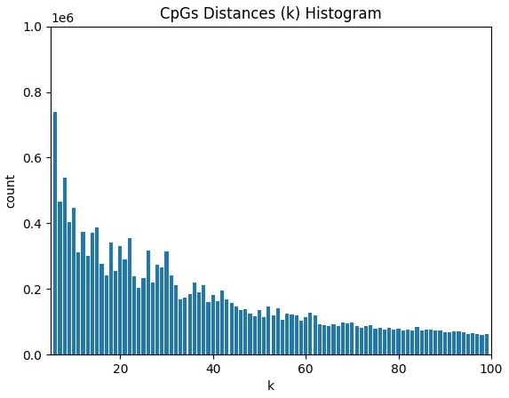
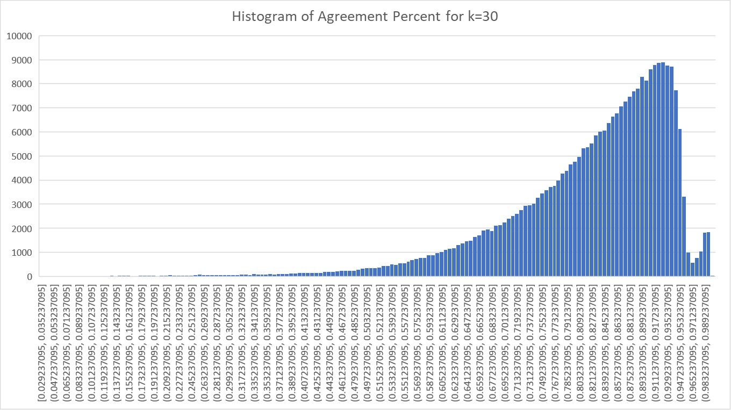
Building the Dataset
Parameter evaluation
  Choosing distance length between CpG pairs
  Calculating 3 different stats, and choosing one for mapping
    Meth -> ?, Unmeth –> ?, #ID -> ?
  Mapping the PDF of the chosen stat
    Selecting n extreme examples from the mapping for the CNN
Notes:
In the #ID param, we try to estimate the percentage of agreement between both CpGs in the pair

Slide 7
Building the CNN
1-hot encoding of the DS we built
  *expand*
Decide on CNN architecture, and train the network
  *expand*
  *Maybe a sketch of the network and its layers*
Build the pipeline
Run

Slide 8
Results

Slide 9
Disccusion
*add further questions and tasks*

